Slide 1
Unit III
Design Process
Prof. Hemangi Patil

Slide 2
Managing Design Processes
Align design with project goals
Cross-functional team collaboration
Use of design tools and documentation
Iterative reviews and feedback cycles

Slide 3
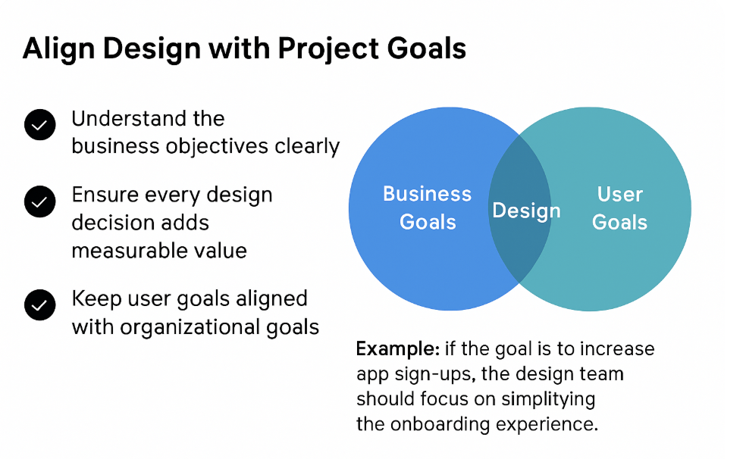
1. Align Design with Project Goals

Slide 4
2. Cross-Functional Team Collaboration
Collaborate with designers, developers, product managers, and stakeholders
Encourage regular team communication and feedback
Build shared understanding and ownership across roles

Slide 5
3. Use of Design Tools and Documentation
Use tools like Figma, Adobe XD, Notion, and Jira
Maintain up-to-date design systems and style guides
Document design decisions for future reference and handoff

Slide 6
4. Iterative Reviews and Feedback Cycles
Conduct frequent design critiques
Gather stakeholder and user feedback regularly
Use agile workflows and rapid prototyping for continuous improvement

Slide 7
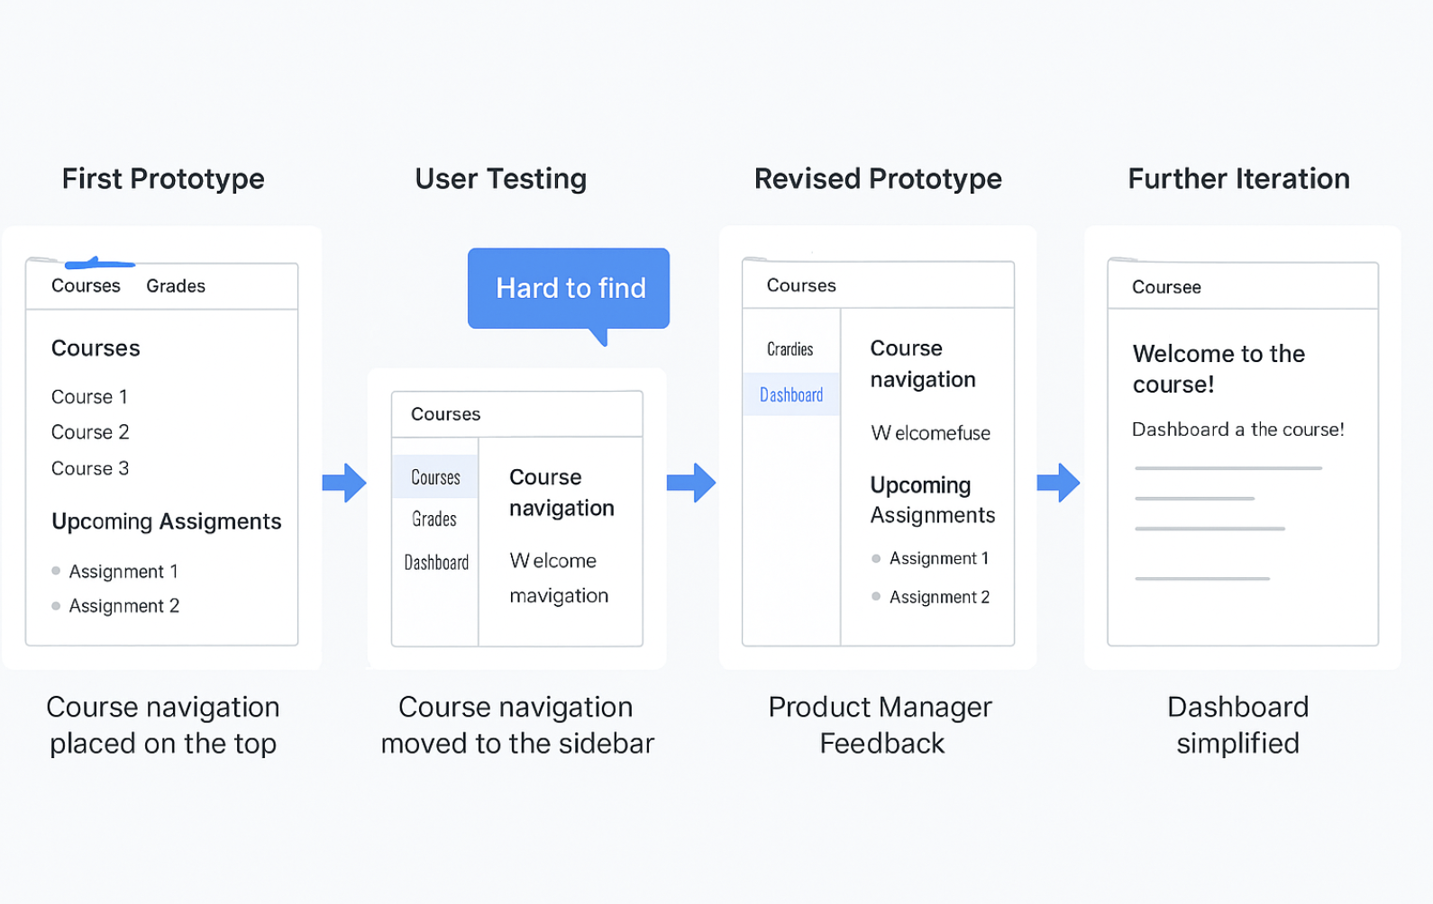
Iterative Feedback Loop – Real-life Example

Slide 8
Organizational Design to Support Usability
Integrate UX teams in project lifecycle
Promote a user-centered culture
Provide training and usability resources
Appoint usability advocates or champions

Slide 9
Organizational Design to Support Usability
Creating Structures that Foster User-Centered Design

Slide 10
Why Organizational Design Matters
Usability is not just a design team concern — it’s an organizational commitment.
eams, processes, and leadership must all support user-centered thinking.

Slide 11
Integrate UX Teams in Project Lifecycle
Include UX professionals from the start of the project
Involve them in:
- Requirements gathering
- Planning and prioritization
- Development sprints
- Testing and evaluation

Slide 12
Promote a User-Centered Culture
Encourage cross-functional empathy for the user
Involve developers, managers, and testers in user testing
Celebrate user feedback and usability wins

Slide 13
Provide Training and Usability Resources
Conduct UX workshops and training
Share usability guidelines and design systems
Provide tools for:
- Accessibility checks
- User testing
- Feedback collection

Slide 14
Appoint Usability Advocates or Champions
Nominate usability champions in every team
Their roles:
- Advocate for user needs in planning meetings
- Educate peers on usability best practices
- Ensure accessibility and consistency

Slide 15
Pillars of Design Usability
Aesthetics, Functionality, Accessibility, Consistency, Feedback, Error Prevention

Slide 16
Aesthetics
Visual design that is clean, attractive, and purposeful. Helps reduce cognitive load and creates positive emotional response.

Slide 17
Functionality
Ensures the product works as intended. Users can complete tasks smoothly and efficiently without bugs or glitches.

Slide 18
Accessibility
Design for all users, including those with disabilities. Use high contrast, alt text, keyboard navigation, and screen reader support.

Slide 19
Consistency
Use familiar patterns and design elements throughout the product to build trust and reduce the learning curve.

Slide 20
Feedback
Let users know the system is working. Use indicators, confirmations, error messages, and status updates.

Slide 21
Error Prevention
Design to avoid user errors with clear instructions, constraints, confirmations, and undo options.

Slide 22
Development Methodologies
Waterfall Model
Agile UX
Lean UX
Design Sprints
Double Diamond Model

Slide 23
Why Development Methodologies Matter
UX design is deeply connected to how products are developed.
Methodologies affect collaboration, iteration, and delivery.
Each model offers a different level of flexibility and user involvement.

Slide 24
Waterfall Model
Linear and sequential process
Phases: Requirements → Design → Development → Testing → Deployment
Difficult to go back after completion of a phase
Limited user feedback and iteration
Best for well-defined projects

Slide 25
Agile UX
Combines UX with Agile development
Short sprints with continuous iteration
Regular feedback and updates
Encourages team collaboration and fast delivery
Supports user-centered design throughout

Slide 26
Lean UX
Focuses on learning over documentation
Rapid prototyping and user testing
Measures outcomes to adapt quickly
Encourages building only what's necessary to validate ideas
deal for startups and fast-paced environments

Slide 27
Design Sprints
5-day process to solve problems and test ideas
Steps: Understand, Sketch, Decide, Prototype, Test
Aligns teams and reduces development risks
Validates ideas before investing heavily
Promotes quick innovation

Slide 28
Double Diamond Model
Four phases: Discover, Define, Develop, Deliver
Encourages divergent and convergent thinking
Helps teams explore and focus on the right problem
Maintains user-centered approach throughout design cycle

Slide 29
Waterfall: Fixed-scope, early design only
Agile UX: Iterative, continuous UX involvement
Lean UX: Fast testing, minimal documentation
Design Sprint: Rapid validation, innovation
Double Diamond: Structured, user-focused design process

Slide 30
Human Considerations in Design
Human considerations in design focus on making products usable, efficient, and enjoyable for people.
Why it matters:
Enhances user satisfaction
Reduces errors & frustration
Promotes inclusivity

Slide 31
Human Considerations in Design
Cognitive Load
Memory Limitations
Visual Perception
Accessibility for all users (including disabilities)
Emotional Design

Slide 32
Cognitive Load
Meaning: The mental effort needed to understand and interact with a design.
Impact: High cognitive load causes confusion, delays, and mistakes.
Design tips:
Keep interfaces simple and uncluttered.
Use grouping & hierarchy to organize information.
Show one major task at a time.
Example: Step-by-step checkout in e-commerce reduces overload.

Slide 33
Memory Limitations
Human short-term memory holds ~7±2 items at once.
Overloading memory → user frustration and errors.
Design strategies:
Use recognition over recall (visible options instead of remembering commands).
Provide consistent cues (icons, color coding).
Offer auto-suggestions and history.
Example: Search engines showing recent queries.

Slide 34
Visual Perception
People scan visually in patterns (e.g., F-shape for web pages).
Use contrast, color, and spacing to guide attention.
Avoid overuse of bright or conflicting colors.
Consider color-blind friendly palettes.
Example: Call-to-action buttons in contrasting colors stand out.

Slide 35
Accessibility for All Users
Accessibility ensures usability for people with disabilities (visual, auditory, motor, cognitive).
Standards: WCAG (Web Content Accessibility Guidelines).
Design tips:
Alt text for images.
Keyboard navigation.
Captions/subtitles for audio & video.
Adjustable font sizes & high-contrast mode.
Example: Screen-reader compatible websites for visually impaired users.

Slide 36
Emotional Design
Design that triggers positive feelings in users.
Emotions influence trust, satisfaction, and loyalty.
Strategies:
Appealing visuals and brand-consistent colors.
Delightful micro-interactions (animations, sounds).
Storytelling in user experience.
Example: Apple's product unboxing creates excitement before use.

Slide 37
Case Study
Banking App Redesign:
Before:
Complex menus, no accessibility options, plain visuals.
After:
Simplified navigation.
Accessible features for visually impaired.
Color-coded alerts.
Friendly tone in messages.
Result: 35% increase in customer satisfaction.

Slide 38
Usability – Principles to Support Usability
Learnability
Efficiency
Memorability
Error Tolerance
Satisfaction
Feedback and visibility

Slide 39
Introduction
Definition: Usability is the extent to which a product can be used effectively, efficiently, and satisfactorily by specified users to achieve specified goals in a specified context.
Why it matters:
Enhances user productivity
Reduces errors
Improves satisfaction and trust
Usability is a core part of UX design.

Slide 40
Learnability
How easy it is for a new user to accomplish basic tasks the first time they encounter the design.
Low learning curve encourages adoption.
Design tips:
Keep layouts intuitive and consistent.
Use familiar icons, terms, and navigation.
Provide onboarding guidance and tooltips.
Example: Mobile apps with guided walkthroughs.

Slide 41
Efficiency
How quickly users can complete tasks once they’ve learned the design.
Saves time and effort for frequent users.
Design tips:
Provide shortcuts for expert users.
Optimize workflows with fewer clicks.
Reduce redundancy in interactions.
Example: Keyboard shortcuts in professional software.

Slide 42
Memorability
How easily returning users can reestablish proficiency after a period of not using the design.
Reduces retraining and frustration.
Design tips:
Keep key functions in consistent places.
Use predictable interaction patterns.
Avoid overcomplicated custom gestures.
Example: Consistent menu locations in Microsoft Office.

Slide 43
Error Tolerance
The system’s ability to prevent, detect, and recover from user errors.
Prevents frustration and loss of work.
Design tips:
Provide undo/redo options.
Offer confirmation for destructive actions.
Use error messages that are clear and actionable.
Example: Gmail’s “Undo Send” feature.

Slide 44
Satisfaction
The degree to which users enjoy and are comfortable with the design.
Satisfied users are more likely to continue using and recommend the product.
Design tips:
Aesthetically pleasing design.
Personalization options.
Positive emotional engagement.
Example: Spotify’s personalized playlists and visuals.

Slide 45
Visibility
Making important information and options easily discoverable.
Avoids hidden features and confusion.
Design tips:
Keep primary actions visible without deep navigation.
Use clear labels and icons.
Make current system status visible.
Example: Visible “Play/Pause” buttons in media players.

Slide 46
Assessment in the Design Process
Conduct usability testing
Analyze user feedback
Use analytics and performance metrics
Iterate design based on data and insights

Slide 47
Why assessment matters:
Ensures the design meets user needs.
Helps identify usability issues early.
Informs decisions with real data.

Slide 48
Conduct Usability Testing
Observing real users as they attempt tasks.
Purpose: Identify barriers, confusion, and inefficiencies.
Best practices:
Test with representative users.
Provide realistic tasks.
Observe without interfering.
Example: Testing a mobile banking app to see if users can transfer funds without assistance.

Slide 49
Analyze User Feedback
Sources:
Surveys & questionnaires.
Interviews & focus groups.
App store reviews & social media comments.
Benefits:
Understand pain points directly from users.
Prioritize changes based on common issues.
Example: E-commerce site changes checkout process after users complain about too many steps.

Slide 50
Use Analytics & Performance Metrics
Tools: Google Analytics, Mixpanel, Heatmaps, A/B testing tools.
What to measure:
Task completion rates.
Time on task.
Drop-off points.
Click paths.
Example: Analytics reveal that 40% of users abandon sign-up after the payment step → prompts redesign.

Slide 51
Iterate Design Based on Data & Insights
Improving design in cycles using test results and feedback.
Benefits:
Continuous improvement.
Aligns design with evolving user needs.
Approach:
Prototype → Test → Analyze → Refine.
Repeat until usability goals are met.
Example: Social media app updates navigation based on repeated feedback and engagement data.

Slide 52
Usability Problems
Usability issues are a major reason why products fail to engage users.
They can lead to frustration, mistakes, and even complete abandonment of the product.
Some common issues include: inconsistent navigation, overcrowded layouts, missing feedback, slow performance, and designs that exclude people with disabilities.
Recognizing these early helps in creating smoother, more enjoyable user experiences.

Slide 53
Inconsistent Navigation
When menus, labels, or page structures keep changing, users struggle to find their way.
It breaks their mental map of the product and forces them to relearn navigation each time.
Designs that keep navigation consistent across screens and use familiar patterns make it easier for people to explore and accomplish tasks.

Slide 54
Cluttered User Interface
Packing too much information, too many buttons, or too many visuals into one screen overwhelms the user.
The most important actions and information get buried under visual noise.
Clean layouts with clear hierarchy, adequate spacing, and focus on the essentials help users concentrate on what matters.

Slide 55
Lack of Feedback or Confirmations
When users perform an action — like pressing a button or submitting a form — they expect a clear response.
Without visual or audio confirmation, they may repeat the action or think the system isn’t working.
Simple indicators such as loading spinners, success messages, or progress bars can reassure users and guide them to the next step.

Slide 56
Poor Performance and Lag
Slow responses, frozen screens, or long load times can cause users to give up entirely.
Every second of delay makes a product feel less reliable and less enjoyable.
Optimizing performance — through faster code, reduced file sizes, and efficient server handling — keeps interactions smooth and responsive.

Slide 57
Accessibility Barriers
If a design ignores accessibility needs, it can shut out a large part of the audience.
Low contrast text, missing alt text for images, or interfaces that can’t be navigated with a keyboard all create barriers.
Designing with accessibility guidelines in mind ensures that everyone, including those with disabilities, can use the product effectively.

Slide 58
Practical Measures of Usability
Usability can’t be judged only by how something looks — we need real measurements of how it performs for actual users.
These measures help:
Identify strengths and weaknesses in design.
Track improvements after changes.
Compare different versions of a product.
Five practical, widely used metrics:
Task success rate
Time taken per task
Number of user errors
User satisfaction ratings
Support/help requests

Slide 59
1. Task Success Rate
This measures the percentage of users who can complete a task without assistance.
High success rate → design is intuitive.
Low success rate → something is unclear or broken.
Often measured during usability testing by setting realistic tasks and seeing how many participants finish them correctly.
Example: If 8 out of 10 users can complete checkout on an e-commerce site, the success rate is 80%.

Slide 60
2. Time Taken Per Task
Even if a task is completed successfully, it matters how long it takes.
Shorter times (without rushing) indicate efficient design.
Long times may mean unnecessary steps, confusing layouts, or performance delays.
Benchmarking this metric over time can show if design changes improve speed.
Example: Redesigning a form so users fill it out in 2 minutes instead of 5.

Slide 61
3. Number of User Errors
Tracks how often users make mistakes while completing tasks.
Fewer errors → design is clear and guides users well.
Frequent errors often point to misleading labels, unclear instructions, or hidden controls.
Designers can fix these by improving affordances, instructions, or layout.
Example: Users repeatedly clicking the wrong button because two actions are placed too close together.

Slide 62
4. User Satisfaction Ratings
Goes beyond efficiency to measure how users feel about their experience.
Collected through surveys like SUS (System Usability Scale) or short post-task ratings.
Combines emotional response with functional evaluation.
Example: A 1–5 rating after each major task, asking “How easy was that to complete?”

Slide 63
5. Support/Help Requests
Measures how often users need to contact support or search for help to complete tasks.
A high number of requests means users can’t find answers or solve issues themselves.
Design improvements should aim to reduce dependency on support by making help features more visible and intuitive.
Example: Adding contextual help tips reduces support calls for password resets.

Slide 64
Objective Measures of Usability
Completion time
Number of clicks or taps
Error frequency
Task efficiency score
Retention of user knowledge

Slide 65
Objective Measures of Usability
Objective measures are quantitative metrics — they are based on facts, not opinions.
They help designers evaluate usability with hard evidence.
These metrics are especially useful for comparing designs, tracking improvements, and making data-driven decisions.

Slide 66
1. Completion Time
Measures how long it takes a user to finish a task from start to finish.
Shorter times usually indicate more efficient design — as long as quality isn’t sacrificed.
Useful for comparing:
Old vs. new designs
Different versions of a feature
Example: Redesigning a checkout flow so users can complete purchases in 1 minute instead of 3.

Slide 67
2. Number of Clicks or Taps
Tracks how many interactions are needed to complete a task.
Fewer clicks often mean a more streamlined process.
Can reveal unnecessary steps or hidden functions.
Example: Simplifying a banking app so transferring money requires 3 taps instead of 6.

Slide 68
3. Error Frequency
Counts the number of mistakes users make while completing tasks.
Common types:
Selecting the wrong option
Entering invalid data
Navigating to the wrong page
Reducing error frequency improves both speed and user confidence.
Example: Changing similar-looking buttons to clearly distinct colors to reduce accidental clicks.

Slide 69
4. Task Efficiency Score
Combines multiple measures (success rate, time, and errors) into a single efficiency metric.
Formula can vary, but often:
Efficiency = (Task Success Rate ÷ Time) – Error Penalty
Helps compare overall usability across different designs or user groups.
Example: Two versions of an app may have similar success rates, but the one with shorter times and fewer errors will have a higher efficiency score.

Slide 70
5. Retention of User Knowledge
Measures how well users remember how to use a product after a break.
Important for tools that aren’t used daily.
Tested by asking returning users to perform key tasks without re-training.
Example: If a user can log in and update their profile after not using an app for 2 weeks, retention is good.

Slide 71
Golden Rules of Interface Design
Strive for consistency
Enable frequent users with shortcuts
Offer informative feedback
Design simple error handling
Permit easy reversal of actions
Support user control and freedom
Offer flexibility and efficiency
Reduce memory load
Use aesthetic and minimalist design
Provide help and documentation

Slide 72
Golden Rules of Interface Design
Good interface design improves usability, efficiency, and user satisfaction.
These “Golden Rules” are based on principles of human-computer interaction (HCI).
Applying them ensures your product is easy to learn, efficient to use, and pleasant to interact with.

Slide 73
1. Strive for Consistency
Keep layouts, terminology, colors, and controls uniform throughout the interface.
Consistency reduces the user’s learning curve.
Example: The ‘Save’ button is always in the same location with the same label across screens.

Slide 74
2. Enable Frequent Users with Shortcuts
Power users often repeat the same actions — shortcuts save them time.
Provide keyboard shortcuts, gesture controls, or quick-access menus.
Example: Ctrl + S for saving, swipe actions in mobile apps.

Slide 75
3. Offer Informative Feedback
Every user action should have a clear response from the system.
Feedback can be visual (loading bars), auditory (alert sounds), or textual (confirmation messages).
Example: Showing “File uploaded successfully” after a user uploads a document.

Slide 76
4. Design Simple Error Handling
Prevent errors where possible, and guide users to recover from mistakes easily.
Use clear error messages that explain the problem and suggest a solution.
Example: “Password must have at least 8 characters” instead of “Invalid password.”

Slide 77
5. Permit Easy Reversal of Actions
Allow users to undo or cancel actions without penalty.
This encourages exploration and reduces fear of making mistakes.
Example: A ‘Trash’ folder where deleted files can be restored.

Slide 78
6. Support User Control and Freedom
Users should feel they are in charge of the system, not trapped by it.
Avoid forcing unnecessary steps or locking users into specific flows.
Example: Allowing users to skip an onboarding tutorial.

Slide 79
7. Offer Flexibility and Efficiency
Adapt the interface for both novice and expert users.
Include features like customization, templates, or advanced options.
Example: A design tool with both a simple mode and an advanced editing mode.

Slide 80
8. Reduce Memory Load
Users shouldn’t have to remember too much information from one screen to another.
Keep important info visible or provide cues.
Example: Showing form field hints while filling out multiple-page forms.

Slide 81
9. Use Aesthetic and Minimalist Design
Remove unnecessary elements that don’t serve the user’s goals.
Keep screens clean and visually balanced.
Example: Google homepage — simple, focused on one main action.

Slide 82
10. Provide Help and Documentation
Even the best design sometimes needs support materials.
Make help easy to access, searchable, and concise.
Example: Context-sensitive help that explains features in the current screen.

Slide 83
Evaluating Interface Design – Introduction
Importance of early evaluation
Measure usability and effectiveness
Discover and fix issues before launch

Slide 84
Introduction to Interface Evaluation
Interface evaluation = systematically checking if a design meets user needs.
Looks at usability, efficiency, and overall experience.
Involves both qualitative (user feedback) and quantitative (metrics) approaches.
Goal: ensure the design works well before, during, and after development.

Slide 85
Importance of Early Evaluation
Catch problems early → cheaper and faster to fix than after launch.
Avoids wasted resources on features users don’t need or can’t use.
Builds user trust by delivering a polished product from day one.
Example: Prototyping and user testing in early stages can prevent costly rework later.

Slide 86
Measure Usability and Effectiveness
Usability: How easy and pleasant it is to use.
Effectiveness: Whether users can achieve their goals accurately and completely.
Methods include:
Task success rate
Time on task
Error frequency
User satisfaction surveys
Regular measurement provides a benchmark for improvement.

Slide 87
Discover and Fix Issues Before Launch
Testing before launch identifies:
Confusing navigation
Inconsistent elements
Accessibility barriers
Performance bottlenecks
Tools & techniques:
Usability testing sessions
A/B testing with prototypes
Expert heuristic reviews
Fixing these early improves adoption rates and reduces negative first impressions.

Slide 88
Expert Reviews
Heuristic Evaluation
Cognitive Walkthrough
Conducted by UX professionals
Efficient, cost-effective method for early feedback

Slide 89
Introduction to Expert Reviews
Expert reviews involve usability specialists evaluating an interface without involving end-users initially.
Purpose: Identify potential usability problems early in the design process.
Benefits: Fast, cost-effective, and does not require a large participant pool.
Often used alongside user testing for comprehensive evaluation.

Slide 90
Heuristic Evaluation – Overview
Method where UX experts review the interface using a set of established usability principles (heuristics).
Focus areas:
Consistency
Feedback
Error prevention
Simplicity
Conducted by multiple reviewers for broader coverage.

Slide 91
Heuristic Evaluation – Process
Prepare list of heuristics.
Experts individually review the interface.
Document problems with examples and severity ratings.
Compile results into a single report.
Outcome: Prioritized list of usability issues to fix before user testing.

Slide 92
Cognitive Walkthrough – Overview
Method where experts simulate the steps a new user would take to complete tasks.
Focus: Learnability and ease of first-time use.
Evaluates whether each step is intuitive and provides enough guidance.

Slide 93
Cognitive Walkthrough – Process
Define user goals and tasks.
Break each task into individual steps.
For each step, ask:
Will the user know what to do?
Will the user notice the correct control?
Will the user get feedback after the action?
Record any points where the process is unclear.

Slide 94
Why Expert Reviews are Efficient
No need to recruit large groups of users.
Can be conducted on early prototypes.
Produces actionable feedback quickly.
Ideal for spotting obvious design flaws before investing in full usability testing.

Slide 95
Cost-Effectiveness of Expert Reviews
Involves fewer people, reducing time and cost.
Early problem detection means cheaper fixes.
Can be repeated multiple times during development without high expense.
Especially useful for startups and small teams.

Slide 96
Combining Expert Reviews with User Testing
Expert reviews identify potential problems early.
User testing later validates findings with real users.
Together, they ensure both expert insight and real-world usability.

Slide 97
Usability Testing
Observe real users using the product
Identify usability pain points
Methods:
In-person or remote
Moderated or unmoderated

Slide 98
Introduction to Usability Testing
Definition: Evaluating a product by testing it with real users.
Purpose: Understand how actual users interact with the product and where they struggle.
Core principle: Watch what users do, not just what they say.
Goal: Improve the design to better match user needs.

Slide 99
Why Usability Testing is Important
Reveals real-world user behavior and challenges.
Identifies pain points before launch.
Reduces development costs by finding issues early.
Improves user satisfaction and adoption rates.

Slide 100
Observe Real Users Using the Product
Direct observation gives insight into:
Navigation patterns
Areas of confusion
Workarounds users create
Techniques:
Screen recording
Eye-tracking
Think-aloud method (users verbalize thoughts while using the product)

Slide 101
Identify Usability Pain Points
Common pain points include:
Confusing navigation
Poor labeling
Overloaded forms
Missing feedback
Slow performance
Prioritize issues based on severity and frequency.

Slide 102
Testing Methods – Overview
Usability testing can vary in location, facilitation, and technology used.
Two main classifications:
In-person vs. Remote
Moderated vs. Unmoderated

Slide 103
In-Person Testing
Conducted in a usability lab or real-world environment.
Benefits:
Direct observation of user reactions.
Immediate follow-up questions.
Drawbacks:
Higher cost.
Limited geographic reach.

Slide 104
Remote Testing
Users test the product from their own location.
Benefits:
Broader reach.
Lower cost.
Drawbacks:
Less control over environment.
Possible technical issues.

Slide 105
Moderated Testing
A facilitator guides the session, asking questions and observing behavior.
Good for exploring user thought processes in depth.
More interactive but requires skilled moderation.

Slide 106
Unmoderated Testing
Users complete tasks without a facilitator present.
Often done using online usability platforms.
Good for quick, large-scale testing but less qualitative insight.

Slide 107
Best Practices for Usability Testing
Test with 5–7 users per round for effective results.
Use realistic tasks and scenarios.
Avoid leading questions.
Record and analyze sessions for patterns.
Iterate and retest after making changes.

Slide 108
Acceptance Tests
Confirm product meets business and user needs
Typically done before release
Involves stakeholders and end-users
Final validation before going live

Slide 109
Introduction to Acceptance Testing
Definition: A formal testing process to verify that a product meets agreed business and user requirements.
Purpose: Ensure the product is ready for release into production.
Acts as the final checkpoint before go-live.

Slide 110
Why Acceptance Testing Matters
Prevents defective or incomplete products from reaching end-users.
Validates that the product delivers promised value.
Protects business reputation and customer trust.

Slide 111
Confirming Business and User Needs
Compare final product against:
Business requirements – Does it meet the agreed scope and objectives?
User requirements – Is it functional, usable, and meeting expectations?
Includes both functional and non-functional criteria (performance, security, usability).

Slide 112
Timing: Before Release
Timing: Before Release
Conducted after system/integration testing is complete.
Ensures no critical issues remain before launch.
If failed, the release is delayed until fixes are made.

Slide 113
Who is Involved
Stakeholders: Business owners, product managers, clients.
End-users: Representative sample of target audience.
QA team: Facilitates test execution and records results.

Slide 114
Acceptance Testing Methods
User Acceptance Testing (UAT) – Performed by actual users.
Business Acceptance Testing (BAT) – Focuses on business process compliance.
Alpha/Beta Testing – Early release to limited audience for real-world feedback.

Slide 115
Key Activities in Acceptance Testing
Review acceptance criteria.
Prepare test scenarios and scripts.
Execute tests with stakeholders and users.
Document issues and re-test fixes.
Sign-off when all criteria are met.

Slide 116
Benefits of Acceptance Testing
Ensures product readiness.
Reduces post-release issues.
Improves user confidence and satisfaction.
Aligns development outcomes with business strategy.

Slide 117
Legal Issues in Interface Design
Interface design is not just about aesthetics and usability — it also has legal responsibilities.
Ignoring legal requirements can lead to lawsuits, penalties, and brand damage.
Key areas:
Accessibility compliance
Privacy and data protection
Security requirements
Copyrights and intellectual property

Slide 118
1. Accessibility Compliance – Overview
Goal: Ensure products are usable by people with disabilities.
Standards:
WCAG (Web Content Accessibility Guidelines)
ADA (Americans with Disabilities Act)
National accessibility laws in various countries.
Covers:
Screen reader compatibility
Keyboard navigation
Color contrast standards
Captions for multimedia

Slide 119
2. Accessibility Compliance – Best Practices
Provide alt text for images.
Ensure high color contrast.
Use semantic HTML for structure.
Provide captions/transcripts for audio/video.
Test with assistive technologies.

Slide 120
3. Privacy Policy Design – Overview
Legal requirement in most jurisdictions when collecting user data.
Laws:
GDPR (Europe)
CCPA (California)
Other regional privacy laws.
Must clearly state:
What data is collected.
How it’s used.
Who it’s shared with.
How users can opt-out or delete data.

Slide 121
Privacy Policy Design – Best Practices
Write in clear, non-legal language.
Make it easy to find on every page.
Use a layered approach: summary + detailed policy.
Provide clear consent mechanisms.

Slide 122
5. Data Protection & Security – Overview
Laws and regulations vary by industry:
HIPAA (healthcare, USA)
PCI-DSS (payment card security)
Local cybersecurity laws.
Design must protect user data from unauthorized access.

Slide 123
Data Protection – Best Practices
Encrypt sensitive data (at rest and in transit).
Use strong authentication methods (MFA).
Regular security testing & penetration testing.
Minimize data collection (collect only what’s necessary).

Slide 124
Copyrights, Licenses & Intellectual Property – Overview
Designers must respect intellectual property laws.
Protect your own creations; avoid infringing on others.
Includes:
Images, fonts, icons, videos, audio.
Software code and UI components.

Slide 125
Copyrights & IP – Best Practices
Use licensed or open-source resources with proper attribution.
Document ownership and licensing of all assets used.
Avoid copying competitor designs.
Register your own trademarks, copyrights, and patents if applicable.

Slide 126
Risks of Ignoring Legal Issues
Heavy fines
Lawsuits and legal settlements.
Loss of user trust.
Brand damage and negative publicity.

